Slide 1
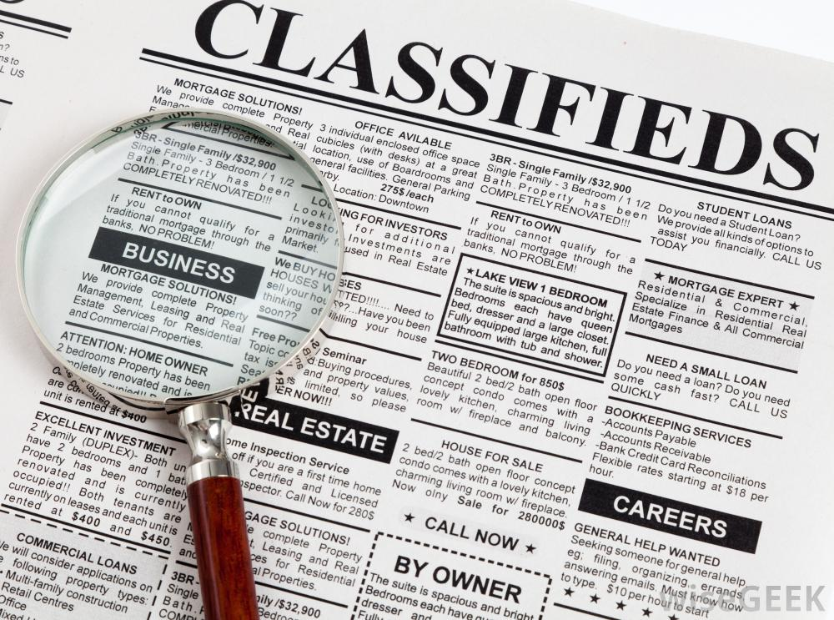
Advertising
Space in a publication sold to other businesses; display ads usually contain headlines, illustrations, copy, a call for action and information to identify the business

Slide 2
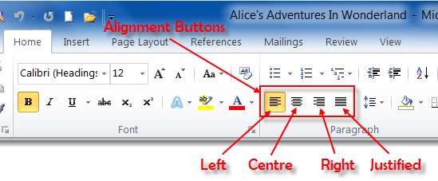
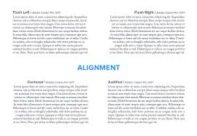
Alignment
Refers to the justification of text at its margins; left, right, centered, justified

Slide 3
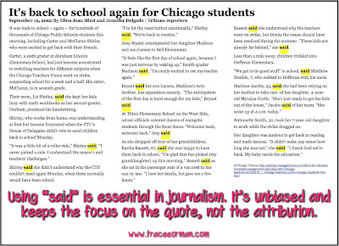
Attribution
Giving credit to sources for information in a story (usually distinguished by the word “said”)

Slide 4
Banner
Headline and story spanning the full width of the front page; usually located at the top of the page

Slide 5
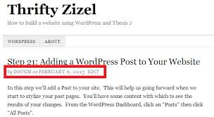
Byline
Name of writer appearing before the lead after the headline

Slide 6
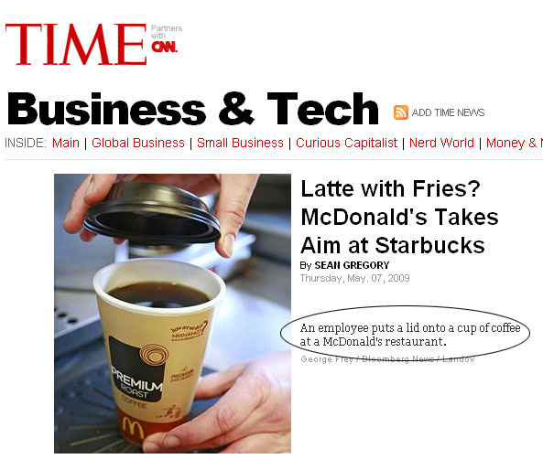
Caption
The portion of the layout which explains what is happening in a photograph. Also called cutlines. Often includes a photo credit.

Slide 7
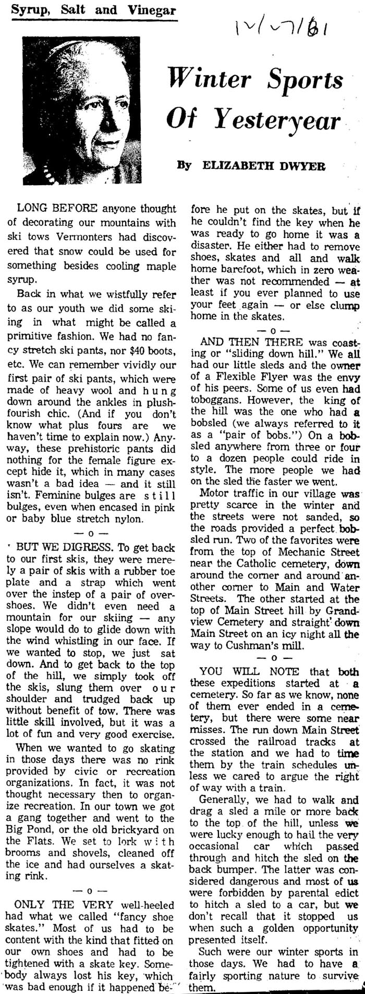
Column
A bylined commentary run on the editorial page

Slide 8
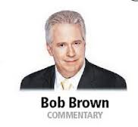
Column Sig
A logo that identifies a continuously run column

Slide 9
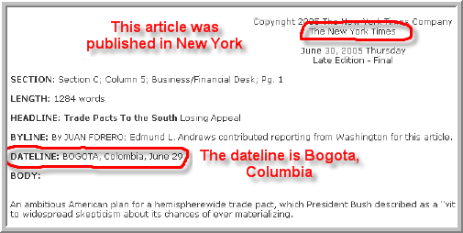
Dateline
A line of type containing a city name, entirely in capital letters, followed in most cases by the name of the state or country

Slide 10
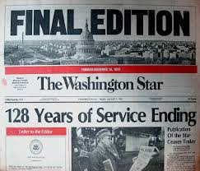
Edition
One issue of the publication which is located just below the nameplate/flag

Slide 11
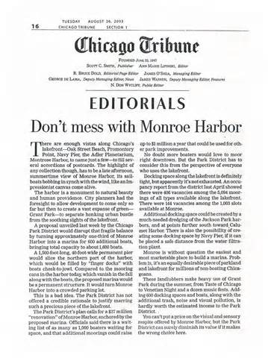
Editorial
A persuasive piece of writing that represents the opinion of the newspaper as a whole.

Slide 12
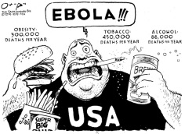
Editorial Cartoon
Cartoon type of drawing that comments on a current event.

Slide 13
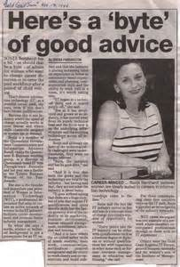
Feature Story
A factual piece designed to entertain or inform the reader and hold interest all the way to the end of the story.

Slide 14
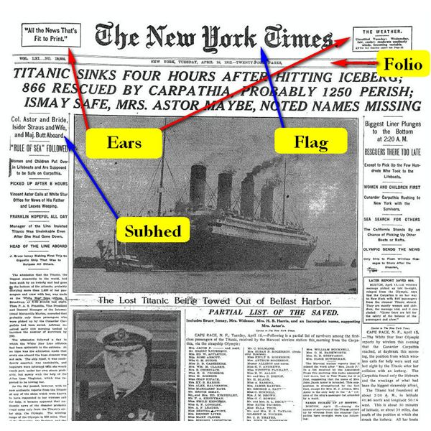
Flag
Name of a newspaper that appears at the top of page 1 (also called a nameplate).

Slide 15
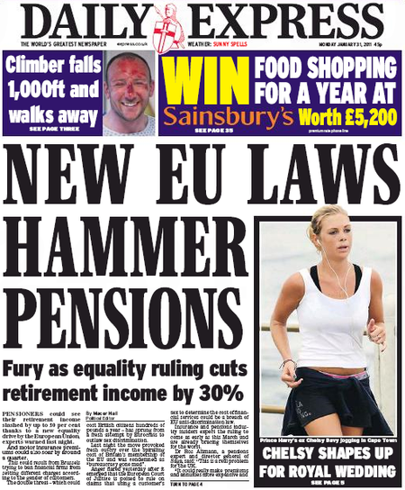
Hammer
A form of headline consisting of a few very large words over a smaller sub headline.
Hammer

Slide 16
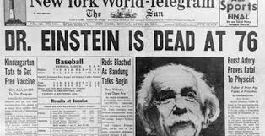
Headline
Large type designed to summarize a story and grab the reader’s attention.

Slide 17
Head Shot
Photo of a person’s face.

Slide 18
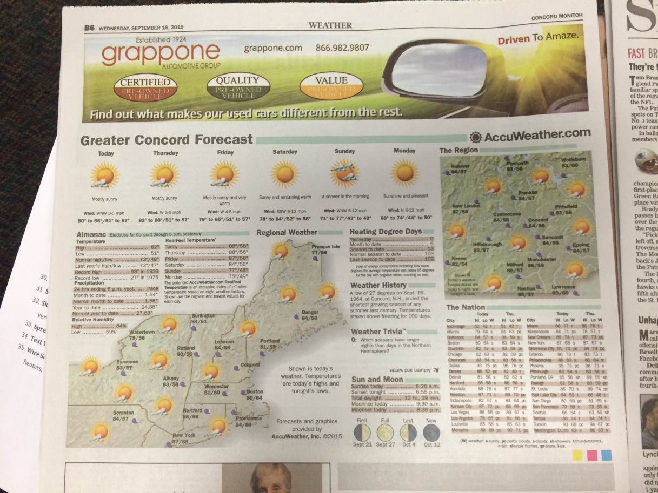
Infographics
Charts, diagrams, graphs, or maps that include illustrations or photography.

Slide 19
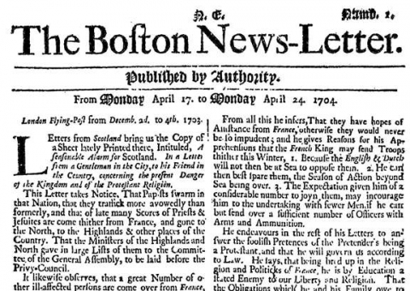
Initial Letter / Drop Cap
A larger first letter set at the beginning of a paragraph (also called a drop cap).

Slide 20
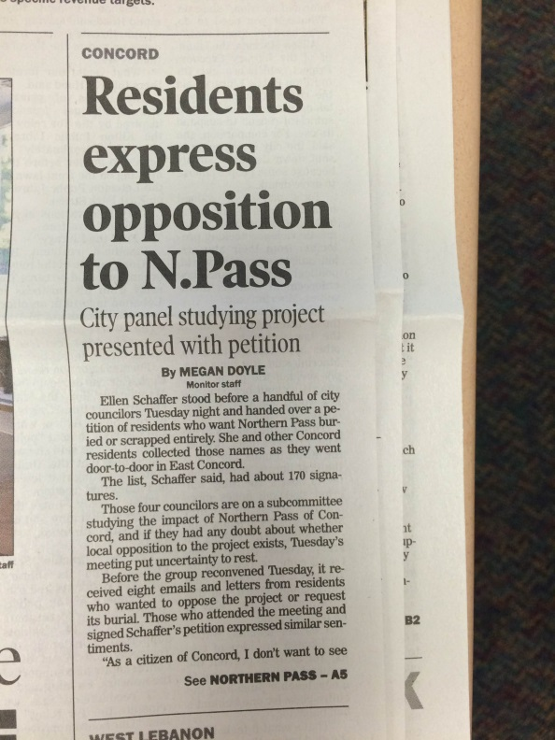
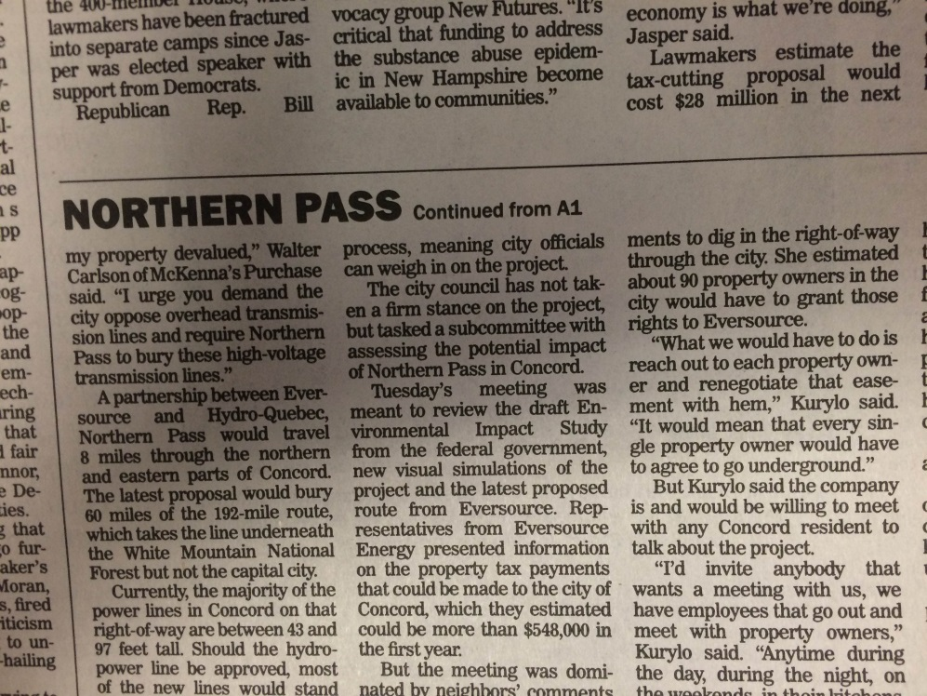
Jump Head
Headline that runs a continued section of a story that began on a different page.

Slide 21
Jump Line
Line used to show reader where to find the rest of the story

Slide 22
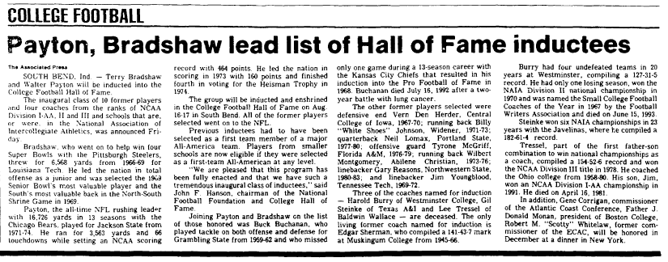
Lead
The opening paragraph of a story

Slide 23
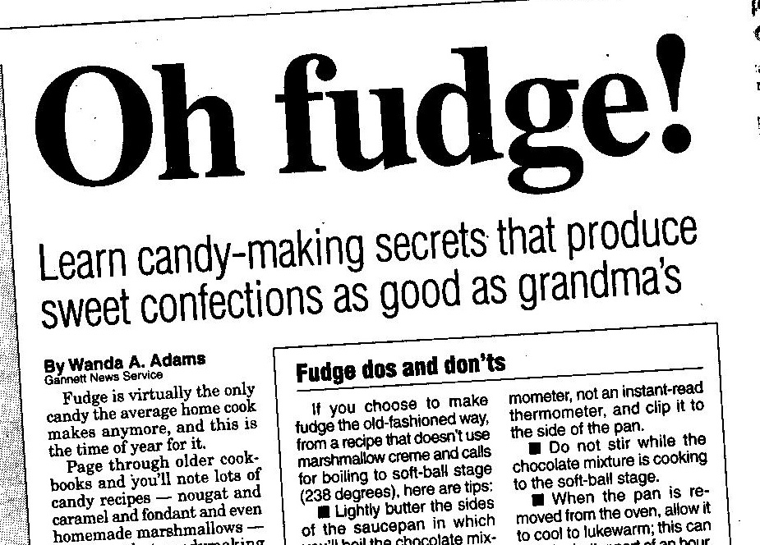
Kicker
In headlines, a smaller sized headline that runs above the main headline

Slide 24
Masthead
Statement of ownership found on the editorial page which includes publishers, staff, location, address, press memberships, editorial policy

Slide 25
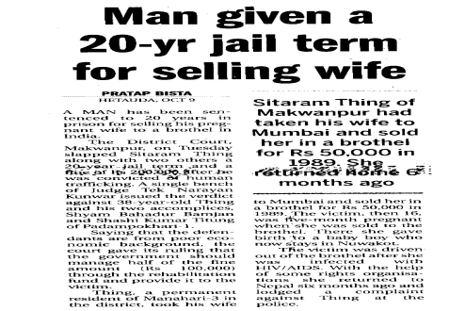
News Story
A factual, unbiased account of an event

Slide 26
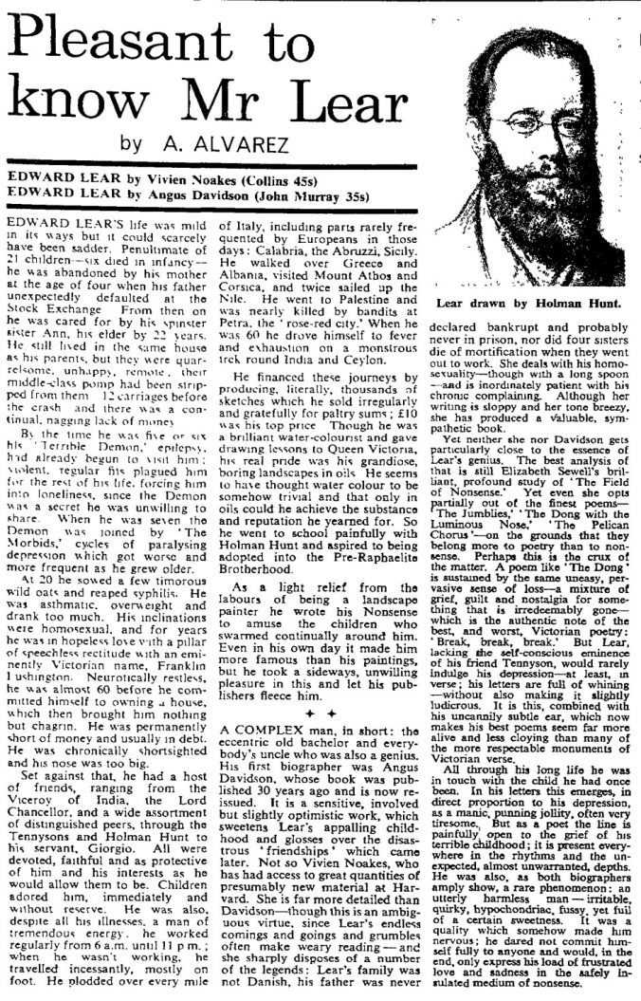
Personality sketch/Profile : a feature story describing a person’s interests, talents, and accomplishments.

Slide 27
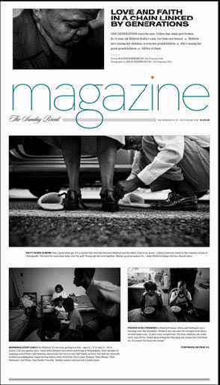
Photojournalism or Photo Essay: reporting a news story by means of pictures. The text, if any, supports the photos and their captions.

Slide 28
Pulled quote:
A direct quote or sentence pulled from the story and blown up to a larger size in order to draw attention. Used as a design element

Slide 29
Quotation: a statement made by another person included in a published story. A direct quotation is exactly what the person said and appears in quotation marks. An indirect quote is a paraphrase of what a person said and does not appear in quotes.

Slide 30
Review: an opinion piece which analyzes and evaluates a creative work.

Slide 31
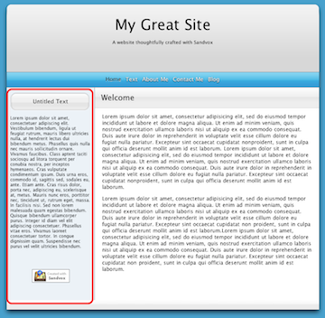
Sidebar
Story that accompanies the main articles and provides a particular angle.

Slide 32
Skybox/Teaser
Index, photos, headlines, lead-ins spanning the first page, whether horizontally or vertically, to draw attention to whats in the newspaper

Slide 33
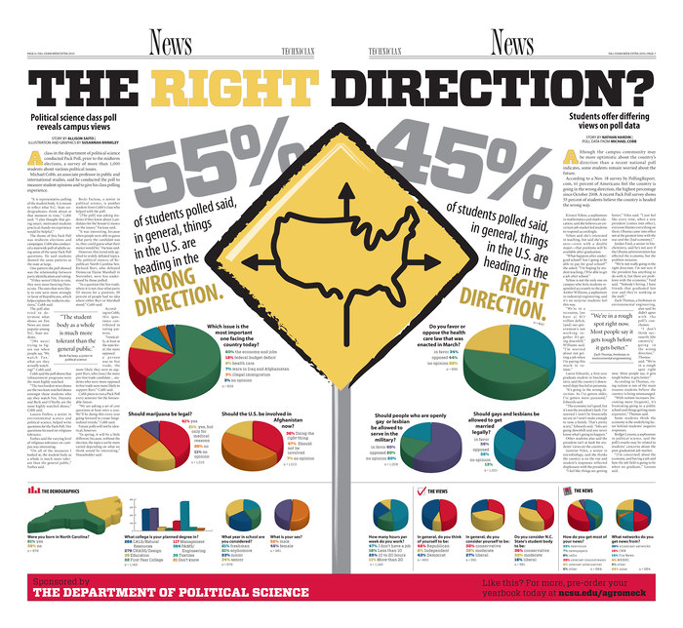
Spread(also called a Double Truck)
Two facing pages that are designed as one unit.

Slide 34
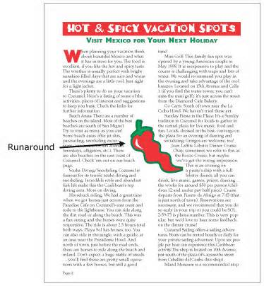
Text Wrap
Adjusting the appearance of text to follow the shape of a graphic.

Slide 35
Wire Service Credit
A news collection and transmission service, such as AP ( for Associated press), Reuters, etc.
WASHINGTON (AP) — Republican presidential candidates not named Donald Trump have raised hundreds of millions of dollars for their campaigns and allied groups. Yet none of that money is being targeted against the celebrity real estate mogul, the party's front-runner through the summer

